Slide 1
NETFLIX Application of Data Science
By
CH.Mamatha

Slide 2
Table Of Contents
Introduction to Netflix Data Science
Netflix Data Science
Personalized Artwork in Netflix Data Science
Art of Image Discovery in Netflix Data Science
Netflix Data Science in Production
Streaming Quality of Experience for Netflix Data Science and A/B assessment for Netflix Data Science

Slide 3
Introduction to Netflix Data Science
Industries are using Data science in creative and exciting ways. Netflix Data Science is flipping up in unanticipated places enhancing the effectiveness of a variety of sectors. It’s powering up human judgment impacting and making the bottom and top outlines of the organization like hardly ever in the past. Industries are delighting large numbers of consumers by powering up their applications with data science and machine learning.

Slide 4
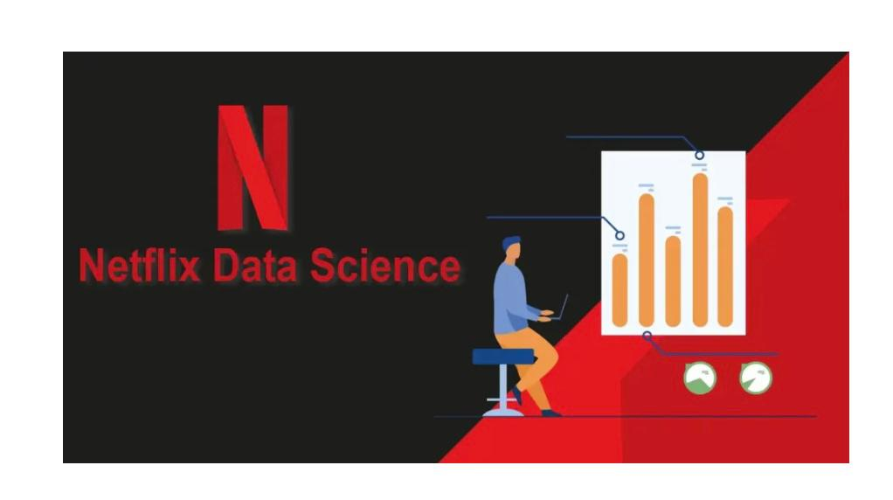
Netflix Data science
Determining individualized appearance for the movies also shows.
Further up the standard format of services streaming by determining concerning video mystery composing, developments in client-side and also server-side algorithms, caching the footage, etc
Notes:
.

Slide 5
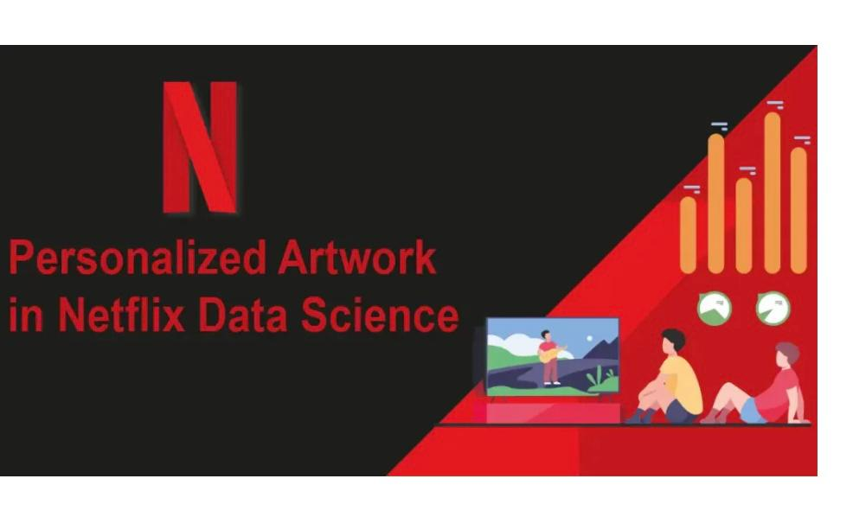
Personalized Artwork in Netflix Data Science
Artwork personalization in Netflix Data Science leads to critical enhancements in learning content by the audience. Artwork personalization is the fact that the original event is not exclusively an individualized recommendation, nevertheless, the suggestion is created for the participants. Netflix continues to positively explore and master this emergent technique.

Slide 6
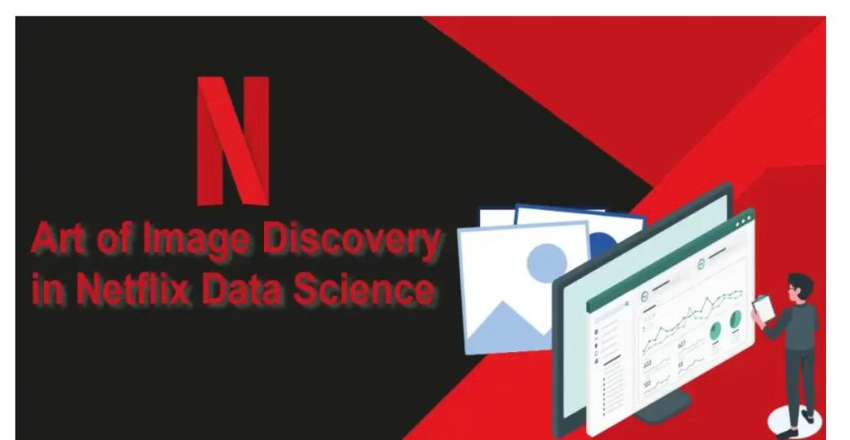
Art of Image Discovery in Netflix Data Science
The other Netflix Data Science action after frame annotation is ranking the pictures. Some elements regarded for ranking are actors, an assortment of photos, content maturity, and so on. Netflix is exploiting deep learning strategies to bunch the photographs of actors throughout a show, rate the most characters, and de-prioritize the secondary figures. The frames with violence in addition to nudity are provided with a deficient score.

Slide 7
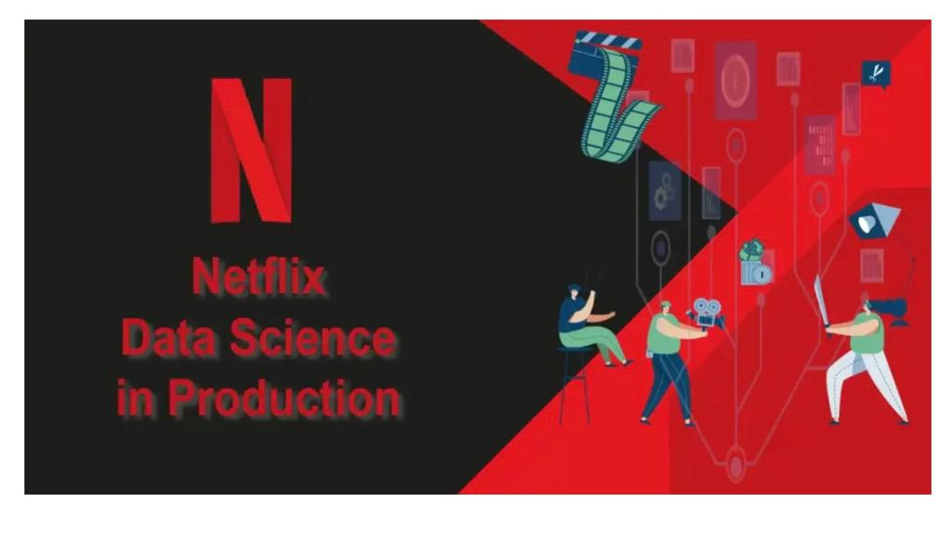
Netflix Data Science in Production

Slide 8
Production consists of shooting a huge number of shots spanning various months. Production can have an aim, nevertheless, it’s to be undertaken under certain limitations. For instance, regulations can be that an actor is available for just one week, a spot is only offered for certain days, the working hours for the crew is 8 hours each day, time restrictions like 1-day shot or nighttime shot, the crew might have to move places between shoots.

Slide 9
Streaming Quality of Experience for Netflix Data Science and A/B assessment for Netflix Data Science
Netflix Data Science is extensively employed for guaranteeing the conventional belonging to the streaming experience. Quality of networking property is foreseen to establish the common format of streaming. Netflix positively predicts that the show heads to be streamed in an extremely precise area and also caches the content in the near server. The caching and saving of content square measure is accomplished as soon as network traffic is minimal

Slide 10
In summary Netflix Data Science, these squares measure certain ways in which Netflix is exploiting information assessment to possess interaction and awe the customers. When you are relating to diving deep and understanding a great deal of about however this wonderful company is exploitation expertise science check out us at Data Trained allowing it to enlist for Data Trained Full-Stack Data Science Program.
Notes:
In summary Netflix Data Science, these squares measure certain ways in which Netflix is exploiting information assessment to possess interaction and awe the customers. When you are relating to diving deep and understanding a great deal of about however this wonderful company is exploitation expertise science check out us at DataTrained allowing it to enlist for DataTrained Full-Stack Data Science Program.

Slide 11


